Slide 1
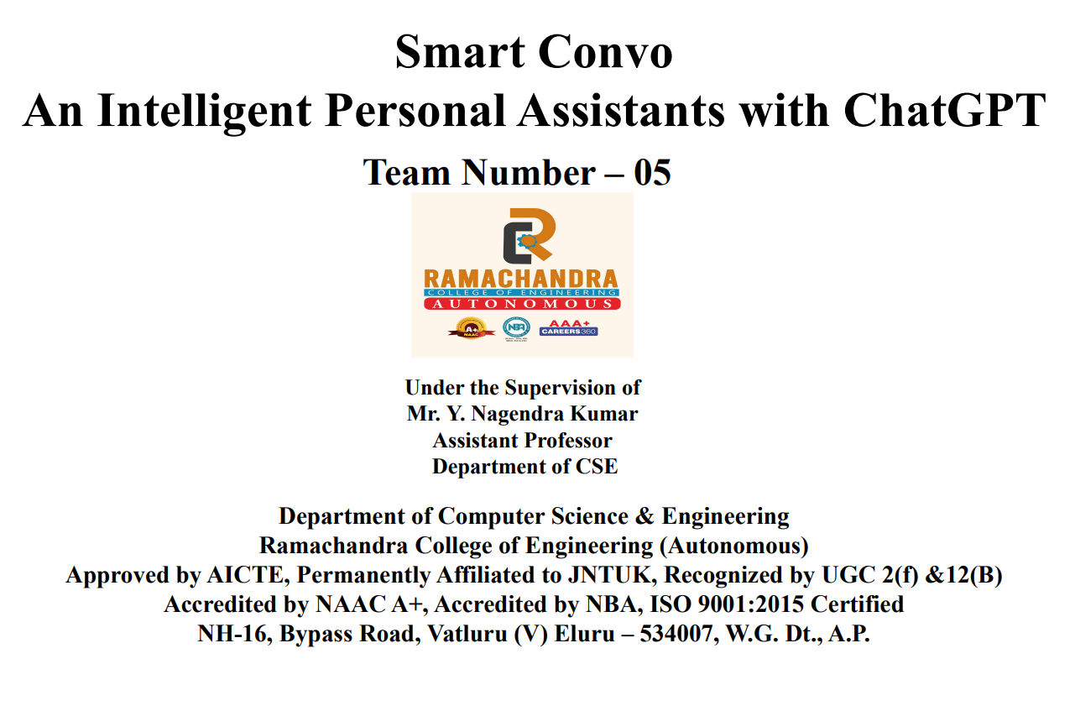

Slide 2
Title-:Smart Convo an AI Assistant with ChatGPT Integration
ABSTRACT
In recent years, voice assistants like Siri and Google Assistant have become integral parts of our daily lives, simplifying tasks and providing information through natural language interactions.
However, users often encounter challenges such as limited contextual understanding, lack of creativity in responses, and occasional misinterpretation of commands. This project aims to address these issues by developing an advanced AI voice assistant seamlessly integrated with ChatGpt . And drap the real time data using perplex ai.
By utilizing the OpenAI GPT API, our assistant can generate rich, descriptive, and contextually relevant responses, surpassing the limitations observed in existing solutions.
it utilizes Perplix AI to fetch real-time data when users ask for it. Overall project aims to create a user-friendly and helpful virtual assistant that can interact with users through text or speech input.

Slide 3
OBJECTIVE:
This integration will elevate the assistant's functionality, fostering a more comprehensive and interconnected digital experience for users
Facilitate effective task and time management for users by implementing features such as setting reminders, scheduling events, and delivering proactive notifications.
This empowers individuals to effortlessly organize tasks, appointments, and to-do lists, ultimately enhancing productivity and time optimization
By integrating ChatGPT, the objective is to instill the assistant with heightened contextual awareness, creative response capabilities, and an improved ability to understand user intent

Slide 4
End User/Beneficiary
General Users: Individuals who seek assistance with various tasks, such as retrieving information, managing schedules, setting reminders, or getting answers to questions.
Students and Educators: Students and educators may utilize the personal assistant for educational purposes, such as accessing educational resources, finding answers to academic questions, or getting assistance with studying and learning.
Journalists and Fact-Checkers: Journalists, fact-checkers, and media professionals may leverage the personal assistant to verify information, gather data.
Businesses and Organizations: Businesses and organizations may deploy the personal assistant internally to improve productivity, streamline information retrieval, automate tasks

Slide 5
Differences between
EXISTING SYSTEM | PROPOSED SYSTEM
Limited Functionality | Real-time Data Retrieval
Manual Information Retrieval | Dynamic and Personalize Responses
Static Responses | InteGrated With External Services like OPENAI
Limited integration | Enhances Efficiency and Productivity

Slide 6
Literature Survey
"Integration of Conversational AI Models with Personal Assistants: A Review" This paper explores existing research and projects that integrate conversational AI models, such as ChatGPT, with personal assistants. It discusses the methodologies, challenges, and applications of such integrations in various domains.
"User-Centric Evaluation of Personal Assistant Integrations with ChatGPT" This study evaluates user perceptions and satisfaction with personal assistant integrations powered by ChatGPT. It investigates factors such as conversational quality, task completion rates, and user preferences to identify strengths and areas for improvement

Slide 7
Software used for the project:
Programming Languages:
Python: Python is commonly used for developing AI-driven applications due to its rich ecosystem of libraries
AI and Libraries:
OpenAI GPT: Utilize OpenAI's GPT (Generative Pre-trained Transformer) models, such as ChatGPT, for natural language processing tasks like understanding user queries and generating responses.
PerplixAI SDK: Leverage the PerplixAI SDK or API for real-time data retrieval, allowing your system to fetch and integrate data from external sources
Platform: visual studio code

Slide 8
Hardware Used
Processor: Intel Core i3 or higher
RAM: At least 2 GB
Keyboard: Any multimedia keyboard
Mouse: Any optical mouse
Hard Disk: Minimum 100 GB

